Slide 1
Strategies for Teaching Multi-Level Groups
Kelly Ryan
Pedagogical Consultant
New Frontiers School Board
Notes:
The structures that we look at today can be used in any learning situation whether you teach academics or vocational.

Slide 2
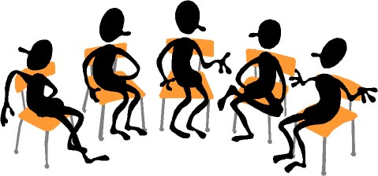
Typical Class
~15 students
Proficient in Literacy and numeracy
Punctual
Low absenteeism
Motivated
Notes:
Let’s start with having a look at what our typical classes or groups look like…..

Slide 3
Activity
Brainstorm your reality in small groups.
Use words and pictures to visually represent your class.
Share with the larger group.
Strategy: Cooperative Learning groups
Positive interdependence
Individual accountability
Equal participation
Recorder
Reporter
Timekeeper
Runner
Leader
Notes:
Cooperative learning is not just organizing students into groups. There has to be built in accountability. It takes time and training…

Slide 4
Overview
Different levels of proficiency
Second language learners
Immaturity
Chronic lateness and absenteeism
Family issues
Work schedules
Perpetual intake
Poor study skills
Notes:
This is what real multi-level looks like….not just students working at different proficiency levels but many other factors that come into play.

Slide 5
Multi-level Possibilities
Whole group-to-small group
Flexible grouping
Stations
Learning tables
Many-to-one
Notes:
We are going to look at 5 different models of group structuring that facilitates learning in a multi-level classroom.

Slide 6
Activity
Strategy: Jigsaw
Read the assigned article silently.
Summarize the content…become an expert.
Each person must teach the other group members about their model of instruction.
Notes:
----- Meeting Notes (15-12-03 19:07) -----
How much time strategy???

Slide 7
Whole Group To Small Group
Whole Class-Opening Activity
Teacher-directed Instruction
Student-directed Activities
Teacher-directed Instruction
Student-directed Activities
Whole Class Activity-Application (Closure)
Notes:
Examples: Start a math class with a real life situation to solve as a whole class. Have students talk it through out loud. This will help clarify concepts for weaker students or students at a lower level as well as provide enrichment to others. Closure activity could be ‘Muddy response”…or some form of formative assessment.

Slide 8
Flexible
Notes:
Variety of situations…When could you use...?

Slide 9
Stations

Slide 10
Learning Tables
Notes:
Example:

Slide 11
Many To One

Slide 12
Activity
Strategy: Think-pair-share
: Eye Contact
Question:
What is one teaching strategy that you use to address the various levels of learners in your group?

Slide 13
Gamification
edTechreview: Apps for classroom use.
Gamification with and without technology

Slide 14
More Structures
Blended Classroom (video)
Rewordify, text-to-speech, dragon dication
Peer to Peer (Homo/heterogeneous groups)
Team Teaching
Resource help in the classroom

Slide 15
Review
Model of instruction depends on the learning context.
Multiple models can be used throughout the day.
Small group instruction and activities encourage cooperation and critical thinking.
Assigning roles increases participation and accountability.

Slide 16
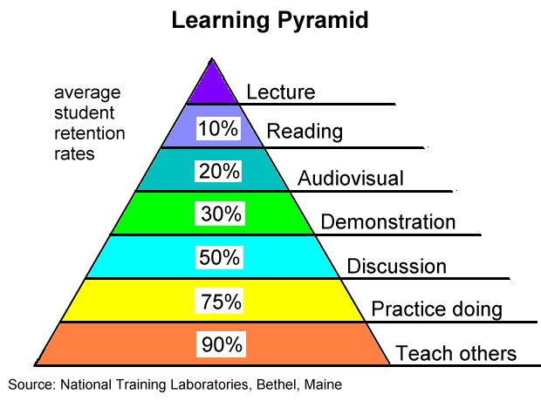
Notes:
WE need to plan activities that address the various needs and levels and learning styles of our students.

Slide 18
When planning lessons…...
Which grouping strategy is best suited for the activity?
How will the information be presented so all students benefit? (lecture, powerpoint, audio....)
Which interactive/cooperative activities are embedded in the lesson?
How will I know where the students are at? (formative assessment)

Slide 19
Formative Assessment
Exit slips
Thumbs
One minute essay
Muddy response
Notes:
Formative assessment helps us know where our students are at so that we can best meet their needs.

Slide 20
Exit Ticket
3 Things that you thought were interesting…
2 Things that you are not quite sure about....
1 Thing you will try next week in your class...

